Slide 1
Speed as a Prime Directive
Ray Krueger
Vice President of Engineering
Hyatt Hotels
Notes:
Welcome

Slide 2
Introduction
Joined March 2015 as Chief Architect
Define standards
Evaluate and prototype new technologies
Review system architectures
Chief Evangelist

Slide 3
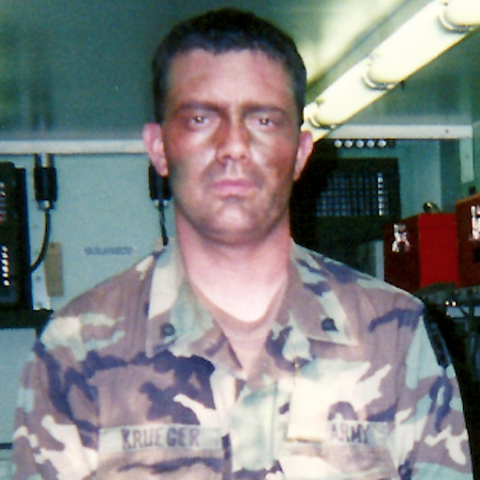
Who’s this guy?

Slide 4
Why optimize for speed?
Your stakeholders demand it
Increase time to recovery
Security
Scalability
Sense of urgency
More experiments
Notes:
If we’re not shipping what the hell are we doing? Shipping quality product quickly is the mission.
If you can build and deploy rapidly you can rollback and replace rapidly
The same applies security, if we need to patch a hole, we do that fast.
Flyer talk slashdot effect, email campaigns
Projects move fast and that pace keep us engaged, without adding a sense of panic. It’s a fine line
Build, Ship, Fail and Learn faster

Slide 5
Define Speed
the rate at which something happens or is done
Notes:
Design
Implementation
QA
Performance
Deployment
Yes. All those things.
Accelerate:
Experimentation
Learning
Discovery
Failure! Fail faster, fail frequently embraced educational event

Slide 6
Where are we coming from?
Technology as a cost center
Legacy technology abound
Heavily influenced by vendor input
17 different hosted environments
No real standards, silos and snowflakes
Operations always playing catch-up
Notes:
Heat, laundry, begrudgingly accepted
AIX, Informix, 4GL, Powerbuilder
Normally speaking to startups and engineers
Vendors decided how things got built, how they’re deployed, and where they run
product development sausage factory
Money goes in, product come out, but you do NOT want to look inside

Slide 7
Where are we going?
Technology as a differentiator
Continuous integration
Continuous delivery
Continuous experimentation
Continuous discovery
Notes:
Make the guest happy, predict wants and needs. Better experiences
Shipping new features as quickly as they’re developed and tested
At some point every experience you have will be part of some experiment
Listening and learning to our customers, paying attention to their wants and needs, adapting

Slide 8
How do we get there?
Great question
Notes:
This is where we get into the meat of it. Time to knock it off with the bullet points.

Slide 9
Open Source First
Vendors Where Necessary
Notes:
Simplify. Why pay ridiculous prices for things like Jboss and Weblogic?
Open Source frameworks power all those things, why not just use those?
Hiring!
Postgres, Mysql, Redis are amazing, and you can pay for support if you need that life insurance
Postgres & Redis can conquer the world
Time to deploy
Time to recover
Time to replace
Control our own fate

Slide 10
Define Standards
Constraints are Liberating
Notes:
List of products in a spreadsheet on sharepoint
Set clear, documented, and visible standards
Logging
Monitoring
Persistence mechanisms
VM sizes
DNS patterns
Data Storage
Security
IETF RFC Process that built the internet
Standards as open source
We gain speed here by paving the path, take the guess work out of all those things

Slide 11
Frameworks
Notes:
Support standards by providing them
Live style guide to support consistent interfaces and experiences
Spring Boot based framework for microservices
Nodejs and Express based framework for browser facing apps
Developers can immediately focus on building features and providing business value
Prototypes come quickly
Get feedback immediately

Slide 12
Testing
Seriously?
Notes:
Unit Tests are obvious
Automated service tests
Performance tests
Interface automation across browsers, Selenium and Saucelabs
Jenkins runs these for us, for almost everything
There are still manual phases where we look for ui/ux problems
Safety net to Release with confidence
Prove an error with reproducible tests rather than “hope that fixes it”

Slide 13
Automation
Fabrication and assembly
Notes:
It seems pointedly obvious to bring this up to this audience, but it’s a key part of our story
In the past everything was manual
Software deployments were manual operated by a vendor using word docs
Email a 40 step word doc, they’d skip 10% and screw up another 20%
VMs built by button clickers
VMs took days, sometimes weeks. Now they take 90 seconds initiated from a Service Now form.
Ansible handles that automation
Rundeck kicks off the jobs
Jenkins builds and distributes software, and also kicks off deployments through Rundeck
Automation is not just a job, it’s our platform

Slide 14
Containers as a Service
Packaging Distribution and Deployment
Notes:
We’re moving everything we can into containers
Packaging
Installshield, tar files, war files, RPMs, debs; all packaging
It’s all fun and games till we start talking about dependencies JVM, Ruby, Node
Distribution
Jenkins builds imags and pushes to Artifactory
Deployment
Jenkins, Rundeck and Ansible deploy immediately
Docker Image assembly Line
Build
Package
Security Scans

Slide 15
Empower Operations
Notes:
You can’t go fast in a rusty pick up truck with bald tires, bad brakes, a rod knock and a steering wheel covered with broken glass
You can, but won’t end well
We have standards, we have automation. Your operations staff must be empowered to say no when folks go Rogue.
They must be empowered to make change
They must have engineering support to do that

Slide 16
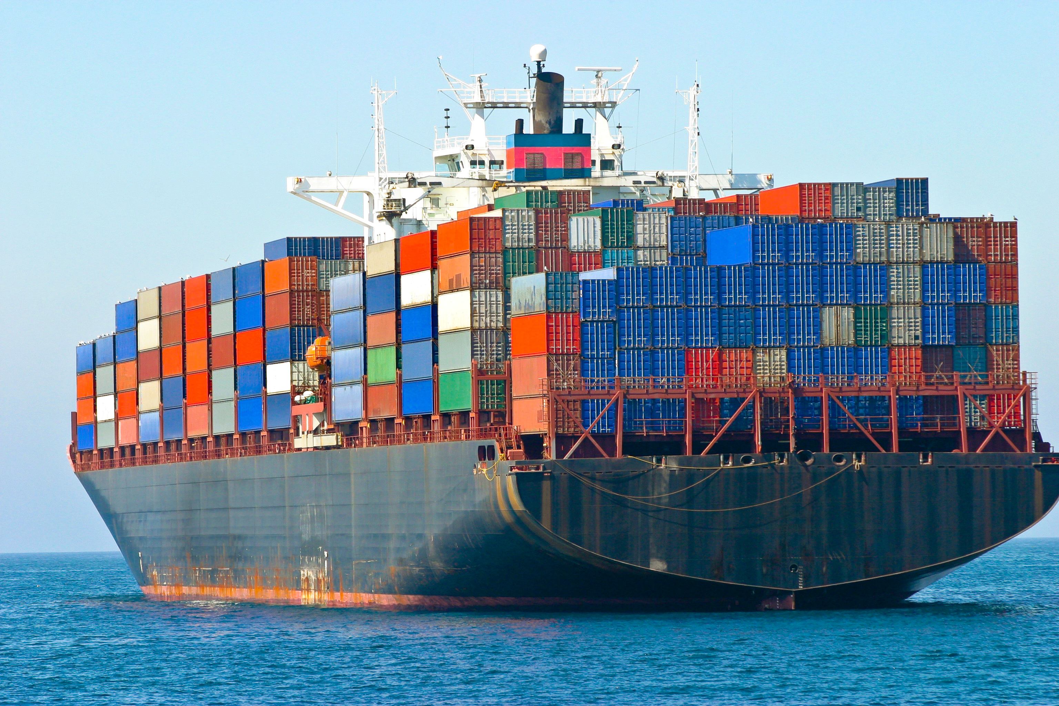
The Usual Analogy
Notes:
This analogy has been out there from day one
It doesn’t convey all the stuff that needs to happen to get there

Slide 17
A better analogy?
Notes:
Containers on tractor trailers or semi trucks are just trailers.
Trailers have no electricity for lights, no air for brakes.
They damn well expect to have that provided by the tractor or cab.
Electricity and Air are infrastructure provided by the environment.
Helpful to think of containers having their infrastructure connected to them.
Engineering builds containers, operations drives the trucks.

Slide 18
Where are we now?

Slide 19
In production of course!
Hyatt.com homepage (desktop only right now)
Header and footer on every page
Promo landing pages
10 new APIs

Slide 20
What is working?
Jenkins, Rundeck and Ansible work great together
Other teams in the organization are getting on board
Folks are excited to work on this stuff
We’re launching new things all the time
We get faster all the time

Slide 21
What has slowed us down?
Until recently this has all been done without much financial investment
The real world
Fear, Uncertainty and Doubt
So much to automate
Notes:
Primarily through evangelism and inspiration
Keeping the lights on and production up
World of Hyatt launch
Slow to recover
FUD At times this all sounds like a lot of new stuff all at once, shaking up comfort zones is takes time
FUD mentioned by Susana and Ben from American Airlines this morning
Everything was so manual there’s just too much to automate so we have to prioritize
SO MUCH OPPORTUNITY

Slide 22
What’s next?
Docker Clustering
More automation
More releases
More experiments
MORE SPEED

Slide 23
THANKS!
twitter.com/raykrueger
linkedin.com/in/raykrueger

Slide 24
This guy really hopes you voted.

